Slide 1

Python Intro
ReDI NRW

Slide 2
Agenda
Teachers and Students introduction
Course and tools introduction
Python introduction

Slide 3
Teachers and students
Introduce yourselves ☺

Slide 4

Name Why this course? What do I expect?

Slide 5

Your thoughts…
Are computers smart?
If not: What/Who makes them appear smart?
Why use a computer then?
What would you like to be able to make a computer do?
Beside instructing a computer: Why would you want to learn a programming language?

Slide 6
Course intro

Slide 7
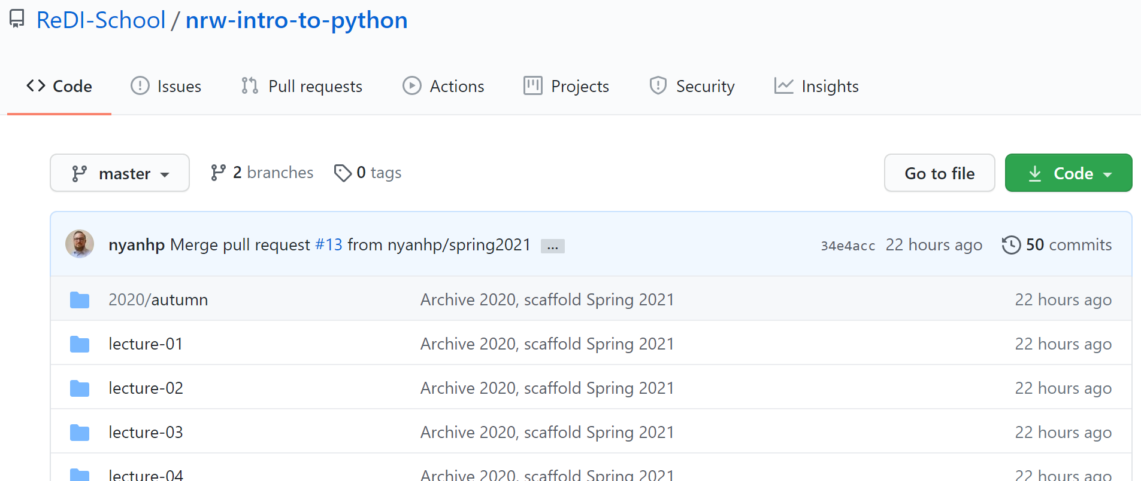
Course Content
https://github.com/redi-school/nrw-intro-to-python

Slide 8
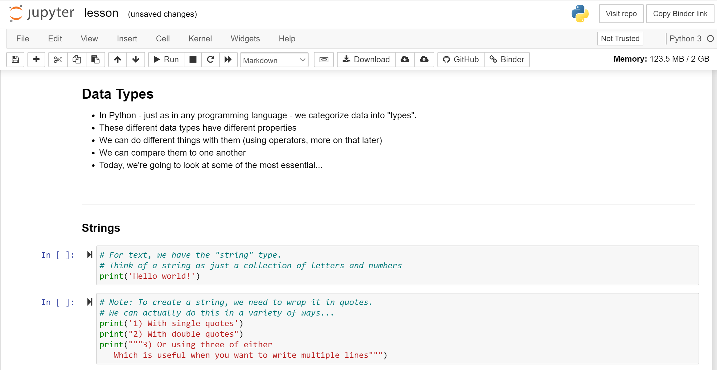
Accessing content without local installation
https://mybinder.org/v2/gh/redi-school/nrw-intro-to-python/HEAD

Slide 9
Additional Tools
Python and IDLE
iPython
Visual Studio Code
PyCharm
…or any other editor

Slide 10
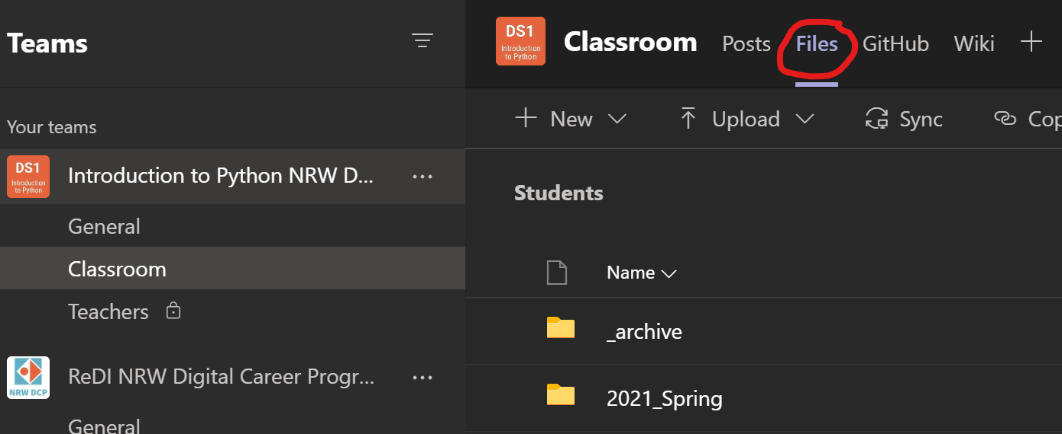
Teams
Join online classes
Find homework
Get help
Upload homework

Slide 11
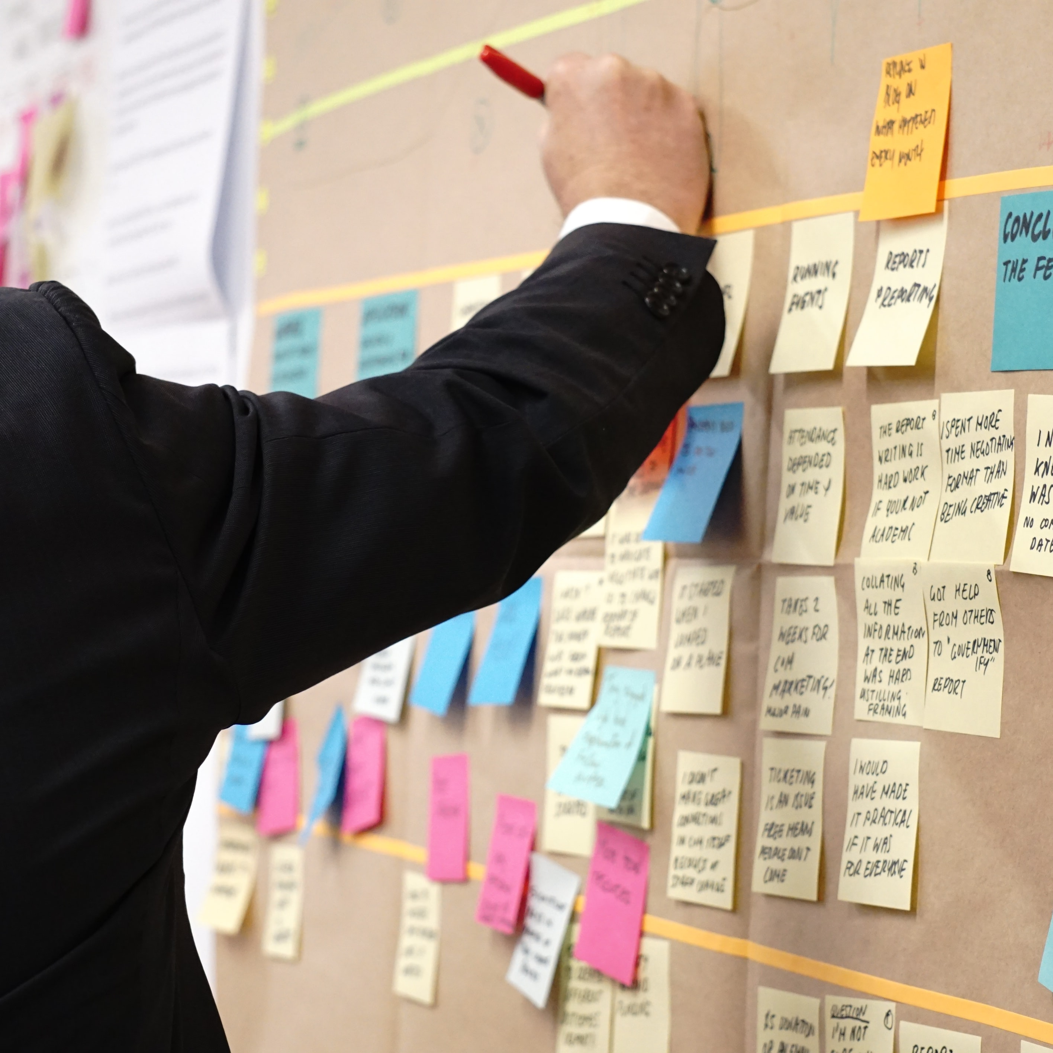
Final project
You get to choose!
Solve a data science problem
Design a REST API
We will prepare you in the upcoming lessons

Slide 12
Python Introduction

Slide 13

A little history
First released 1991
Current version 3.10
Designed by Guido van Rossum
Name pays hommage to Monty Python

Slide 14

What is Python?
All-purpose
Web Development
APIs
GUIs and games
Data science
…
Object-oriented
Interpreted
„Runs without a compiler“
Strongly-typed and dynamically typed
Easy to learn

Slide 15
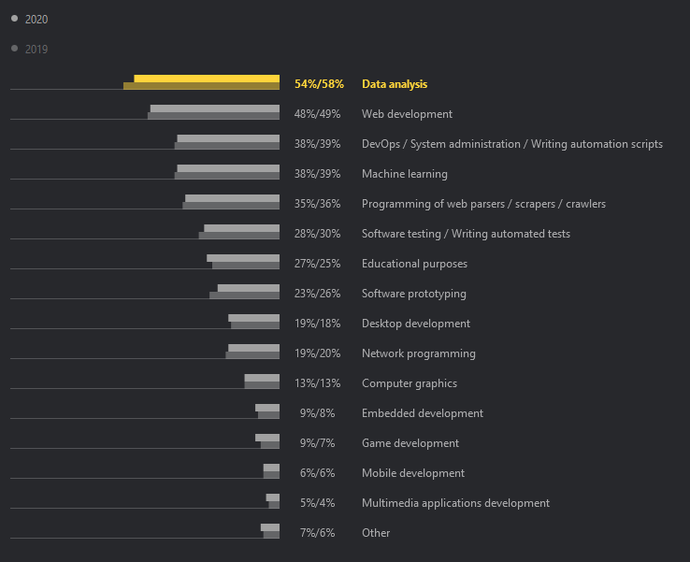
You can build almost anything with Python! Source: JetBrains Python Survey 2020

Slide 16
Python features
„Batteries included“
Many libraries included
Cross-platform
Open-source
Huge ecosystem of libraries
pip (pip installs packages) is used to connect to repositories
Libraries extend functionality greatly
Some libraries will be part of this course: NumPy, pandas, MatPlotLib, FastAPI
Well-structured, (mostly) beautiful code

Slide 17
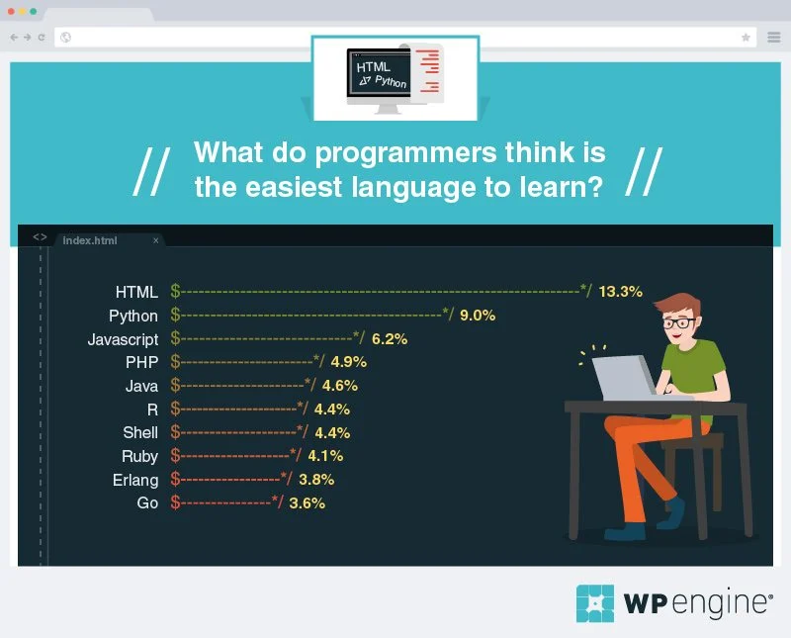
Python is considered easy to learn. Source: 2017 WP Engine Survey

Slide 18

Writing code in Python is easy compared to many other programming languages! Source: xkcd

Slide 19
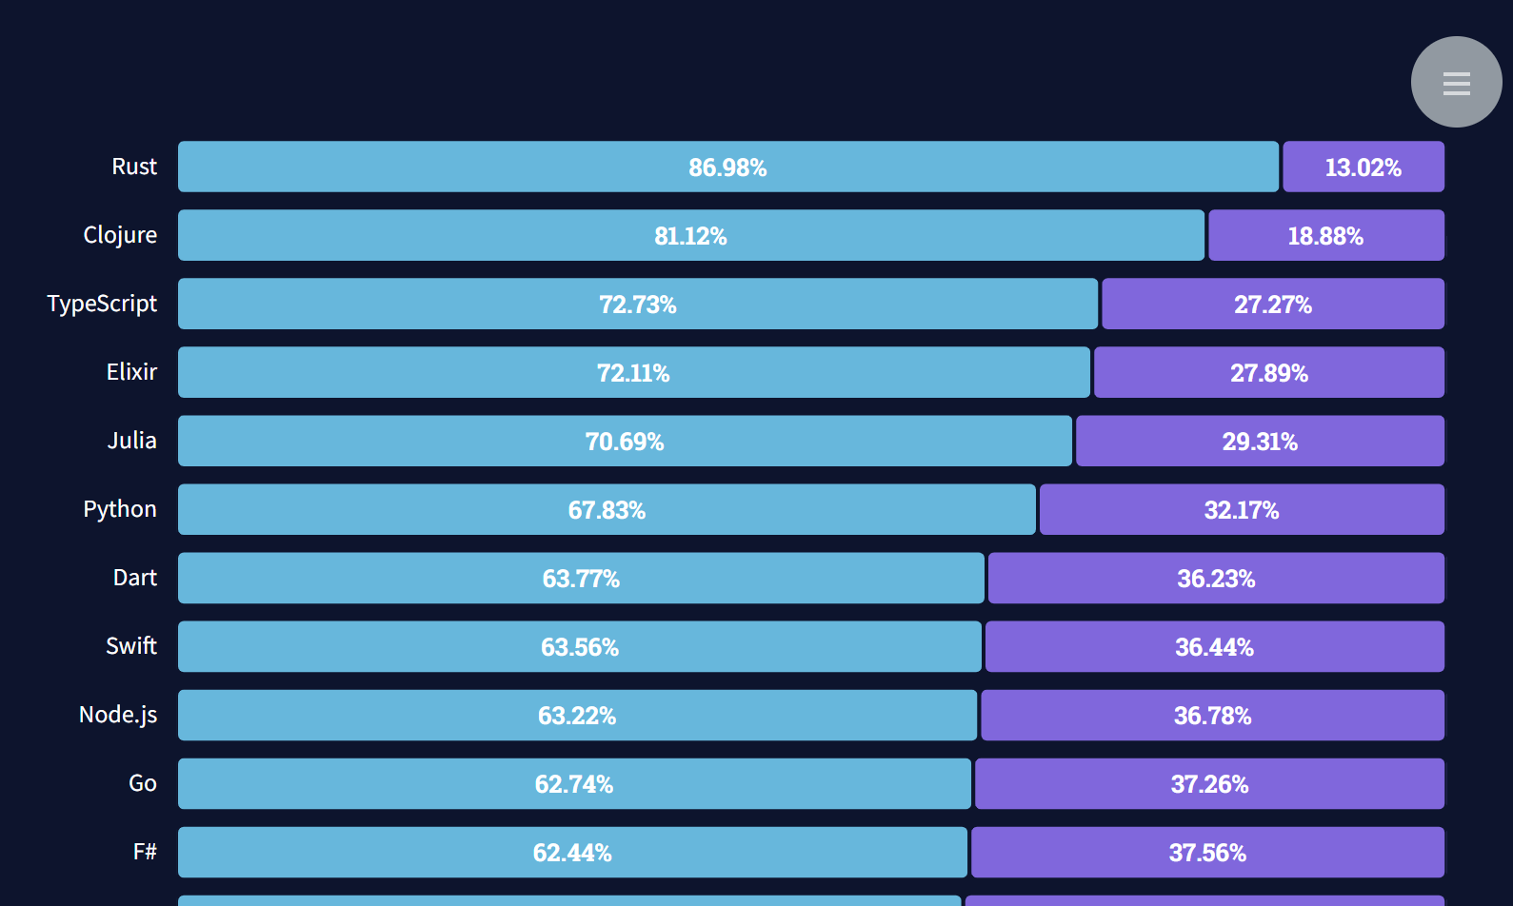
Python is highly appreciated among software developers! Source: 2021 StackOverflow Developer Survey

Slide 20
“Python where we can, C++ where we must”
Google Engineering Team

Slide 21
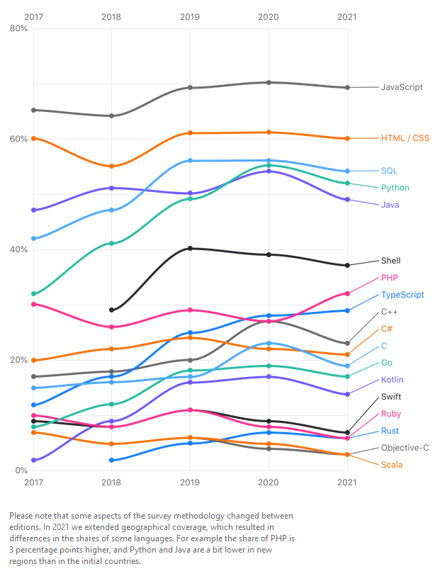
Python is a frequently used programming language! Source: JetBrains DevEcosystem Survey 2021

Slide 22
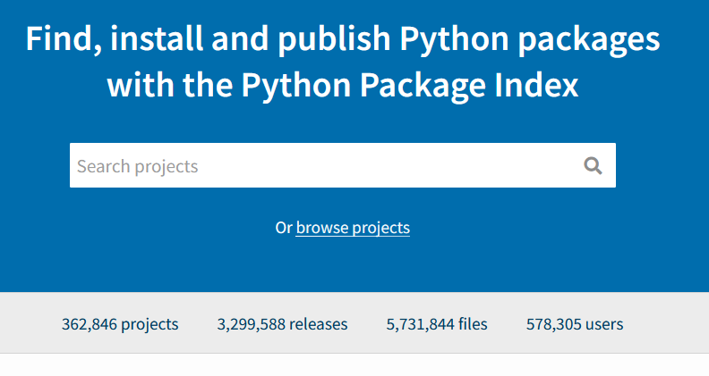
Community
Extended by open-source community
Core components change through PEP
Python Enhancement Proposal
PEP8 https://pep8.org – Style Guide
PEP20 https://pep20.org – the Zen of Python
Massive amount of additional functionality provided through additional packages

Slide 23
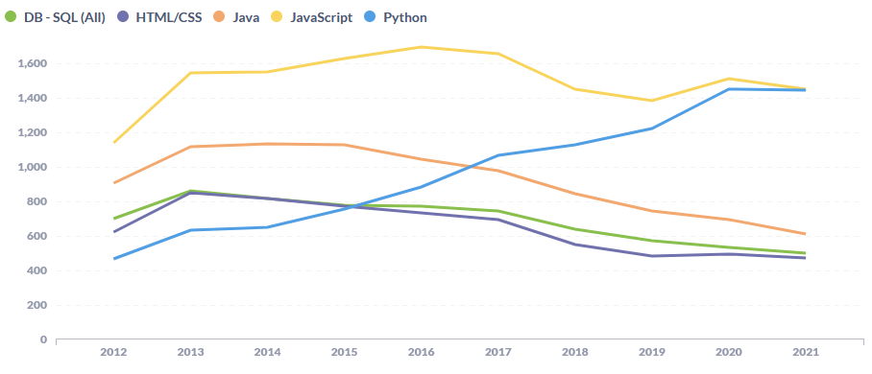
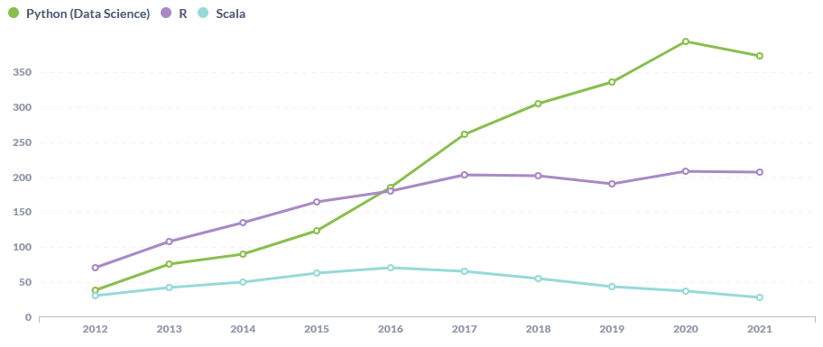
Python Community is extremely active and happy to help! Source: Questions on StackOverflow (https://towardsdatascience.com/popularity-ranking-of-programming-languages-72bcf697ea20)

Slide 24
(An extract of) The Zen of Python
Notes:
Examples for each Zen can be found here: https://github.com/hblanks/zen-of-python-by-example/blob/master/pep20_by_example.py

Slide 25
Beautiful is better than ugly

Slide 26
Simple is better than complex

Slide 27
Complex is better than complicated
Notes:
Complex: Having many related parts
Complicated: Many parts interacting in ways that are difficult to understand.
Requirements may make code complex. Poor decisions (and poor language design) make code complicated.
To keep complex things from getting complicated, try to separate concerns

Slide 28
Flat is better than nested

Slide 29
Readability counts

Slide 30
If the implementation is hard to explain, it’s a bad idea.

Slide 31
Homework
https://forms.office.com/Pages/ResponsePage.aspx?id=Opo3HBpIjEGHV5chJ_yqfyBpv-NKSRVPrnCFDfkSECNUNjFQMDlQQUxLQUwwVVQzS0FPUjZKOVhWViQlQCN0PWcu
Will be graded on Monday March 22nd, so please submit until 16:00 on the 22nd !

